Slide 1
5th Grade Islanders at Queen Anne Elementary
Ms. Goldman
Portable 2

Slide 2
About Ms. Goldman
After trying on various careers, I pursued my M.Ed at the University of Illinois at Chicago. I had meaningful experiences teaching 3rd and 4th grade in Chicago Public Schools before moving back “home” to work as a 4th grade teacher in a wonderfully nurturing Boston-area public school.
As an educator, I am driven to foster learning environments that inspire risk-taking and critical thinking as well as encourage students to envision and create a more socially just world. My background also includes a love for the theater arts and I am continuously looking for ways to incorporate dramatic play into everyday teaching and learning.
Outside of education, my joys in life include playing with my little nieces and nephews, singing karaoke with friends, traveling, basking in nature, and getting sucked into a fantastic book.

Slide 3
Communication
E-mail (best) – szgoldman@seattleschools.org
In person – Schedule a time with me
Website – http://msgoldmanqae.weebly.com
Main form of classroom communication
Twitter – @MsGoldmanQAE
For daily updates on classroom learning

Slide 4
What we believe …
Learning should be meaningful, purposeful and challenging
My most important priority is creating a safe classroom environment to ensure that students feel empowered to take risks with their learning
Social/Emotional learning is foundational to academic growth
Family involvement and communication are critical pieces to your child’s success

Slide 5
Homework
Homework will be purposeful and relevant
Homework will be assigned as needed for extension and review
In 5th grade, homework will be used to support students’ transition to middle school as they develop key study skills such as organization, time management, and responsibility
In addition to reading, students should be working no more than one hour each day after school
Reading – Students are expected to read at least 30 minutes
each day after school
Math – Students are expected to log onto ST Math at home for at least 30 minutes each week
Parent-Child Homework Space and Schedule Assignment

Slide 6
Our daily schedule*
9:30 Attendance and Morning Routine
9:40 PE / Art
10:20 Class Meeting
10:50 Reading / Writing Workshop (and Snack)
12:15 Recess
12:35 Lunch
12:55 Quiet Time
1:10 Math
2:00 Project Time / Science / Social Studies
2:55 Recess
3:10 Read Aloud
3:25 End-of-Day Routine
3:35 Patrol
3:40 Dismissal
*Monday’s schedule differs because students have Monday Morning Meeting and no PE/Art

Slide 7
Our website
http://msgoldmanqae.weebly.com
Check for regular updates on classroom happenings, school events and family communication
Homework assignments will be updated on a daily basis
Read Ms. G’s Blog
Check for updates on local literary and authors’ events

Slide 8
Project Based Learning
PBL is a systematic teaching method that
engages students in learning important knowledge and 21st century skills through an extended, student-influenced inquiry process structured around complex, authentic questions and
carefully designed products and learning tasks.

Slide 9
PBL in 5th Grade
Fall – Models and Designs: The Science of Rube Goldberg
Applying knowledge and engineering skills gained from our 5th grade Science unit on models and designs, students will plan, design, and execute their own original “Rube Goldberg”-style machine. Students will work through the steps of the scientific method to continuously build and revise their machines and critically reflect upon their process throughout.
Spring – How Will You Change the World?
Students will learn about social change through analysis of historical social movements and the leadership of renowned change-makers and activists. Based on research and personal inspirations, students will determine how they, too, will “change the world.”

Slide 10
Positive Discipline – What is it?
Based on the book by Dr. Jane Nelson
Designed to help children become responsible, respectful and resourceful members of community.
Research tells us that children who feel a sense of ‘connectedness’ to community are less likely to misbehave.
FIVE CRITERIA FOR POSITIVE DISCIPLINE
Helps children feel a sense of connection. (Belonging & significance)
Is mutually respectful and encouraging. (Both kind & firm)
Is effective long-term. (Considers what the child is thinking, feeling, learning, and deciding about himself/herself and his/her world – and what to do in the future to survive or to thrive.)
Teaches important social and life skills. (Respect, concern for others, problem solving, and cooperation as well as the skills to contribute to the home, school or larger community.)
Invites children to discover how capable they are. (Encourages the constructive use of personal power and autonomy.)

Slide 11
Positive Discipline in our classroom…
Classroom Meetings
Solution-Based Framework for Problem-Solving
Meaningful Work – Classroom Jobs
Brain in Hand (Self-Regulation)
Safe Space / Calm Body Spot
Encouragement vs. Praise

Slide 12
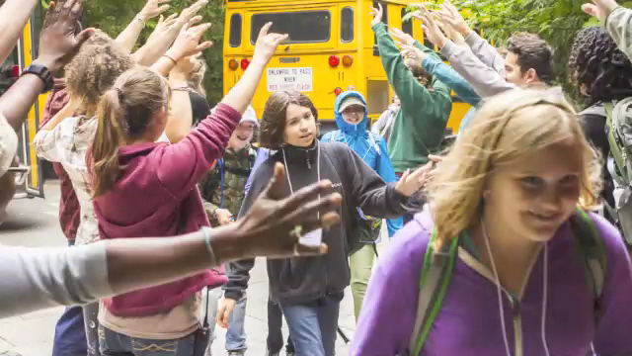
IslandWood

Slide 13
Family Life and Sexual Health (F.L.A.S.H.) Curricula for 5th grade
Please refer to the Seattle Public Schools F.L.A.S.H. website for more information

Slide 14
On your way out…
Please make sure to take with you:
Homework Assignment Packet
Conference Sign-Up form
Hard copies of IslandWood forms
(only if you need them— they are available online)
Thanks so much for coming!

